Slide 1
Writing to Guide - Procedures
Chapter Three
Fatima M.AbuHjeela

Slide 2
Writing to Guide
Guidance Information, also known as step-by- step instruction or procedures, makes up the heart of all task oriented documentation system.
Procedure guides the user from step to step through the task.
Guidance means that the user forfeit a certain amount of control to the manual in order to perform a discrete task, then he or she will resumes control again.
Procedures consist of how-to-do-it explanations, but also require how-it-works and why-it-works overviews. Our job is to balance these elements to meet user informational needs and to make them
efficient and effective in their workplace
Fatima M.AbuHjeela

Slide 3
Writing to Guide
A procedure is a step-by-step series of commands for accomplishing a meaningful operation with a software program.
Most task-oriented documentation takes the form of procedures, also known as step-by-step or how-to documentation.
You must carefully design procedure to maximize the user’s efficiency and effectiveness in the workplace.
Elements you need for effective procedure :
Introduction.
Screenshot, Elaboration.
Tips, tables,…etc
Fatima M.AbuHjeela

Slide 4
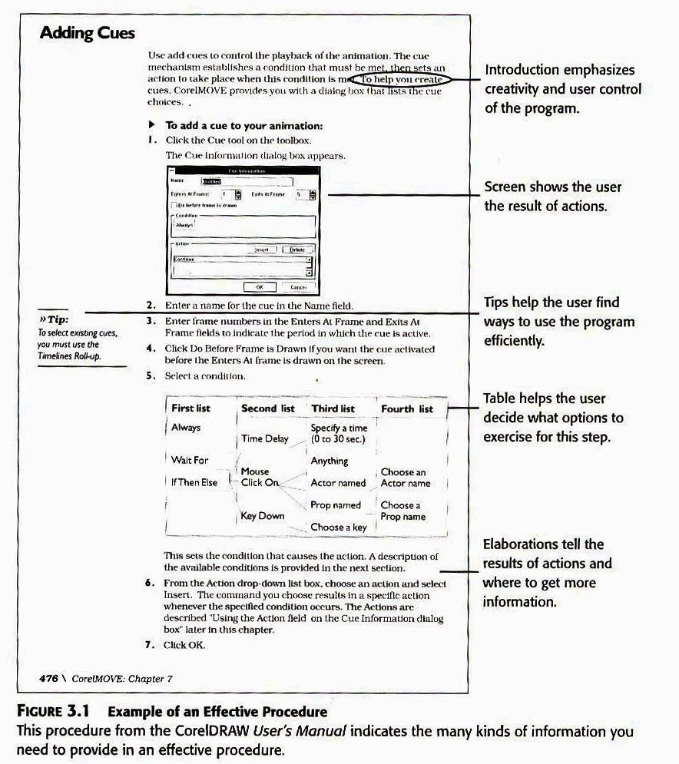

Slide 5
Procedure Guidelines
Relate the task to meaningful workplace activities
The meaning fullness of a procedure comes from its application to work.
The goal of writing procedures is to see them as part of larger activity, as part of the activity/action/operation model.
Procedure occur at the “operation” level.
You must clarify how they fit into the larger picture of the actions and activities in the user’s workplace.
The knowledge the user brings to the procedure comes from the user’s context.
Example:
The user don’t use the draw program just to “add cue” , but they use it to do other workplace actions ,for example : to create multimedia presentation..

Slide 6
Activity Context of a procedure
Asking these questions can help you focus on workplace activities:
1. Resources:
“ What tools do I need to complete this procedure?”
2. Reason :
“ Why do I need this procedure?”
3. Action:
“ What action does this procedure support?”
4. Duration :
” How long will this take? “
5. Community :
“ What information is required by and produced by this procedure? “
6. Error Recovery :
“How do I get out of mistake ?”
Fatima M.AbuHjeela

Slide 7
Procedure Guidelines
2. Determine How Much Information Your User Needs
A richly detailed procedure needs more visuals and a greater amount of information.
A sparse( less detailed ) procedure require only the repeating of the steps in the task description in chronological order .
User analysis and difficulty of the task should indicate whether user needs a lot of detail or not so much.
Electronic presentations allow the user to get more details if he/she needs it at the time. This technique is called layering.
Layering: Formatting technique that allows for different levels of information .
Fatima M.AbuHjeela

Slide 8
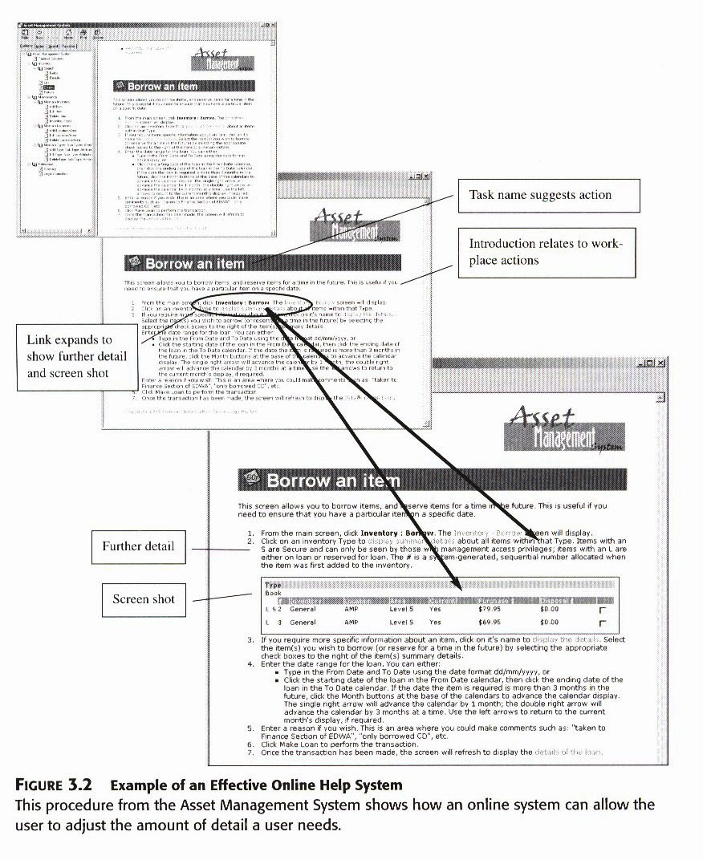

Slide 9
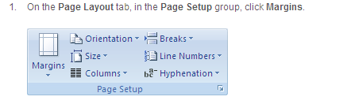
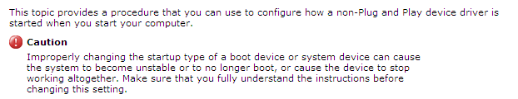
Details You can Include to Enrich Procedure
1. Screen Shots :
Shows actual user interface, what menus to display and what choices to make.
2. Cautions and Warnings:
Cover occasions where the user needs to be careful of possibly damaging an action / product and losing data.

Slide 10
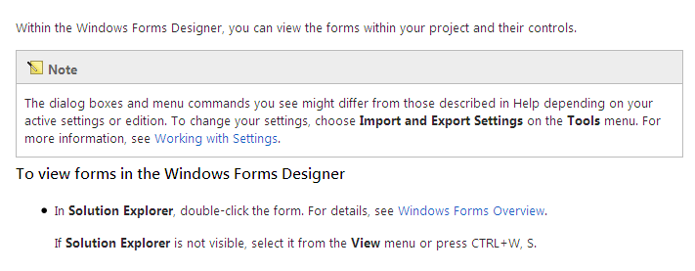
Details You can Include to Enrich Procedure
3. Notes and Tips
Opportunity to suggest alternatives, workarounds or helpful applications to user’s activities. It convey information that elaborates on a step or command.

Slide 11
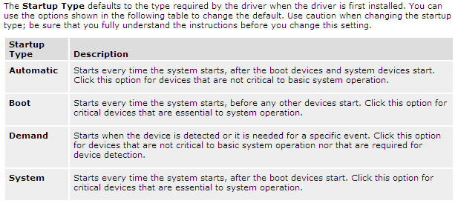
Details You can Include to Enrich Procedure
4. Tables
Allow users with arranged sets of numerical information and text information, or to organize text to support decision making.
You should use table whenever a procedure involves a number of choices.

Slide 12
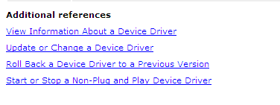
Details You can Include to Enrich Procedure
5. References
Refers to other sections of the manual or other resources.
6. Explanations

Slide 13
3. Choose Appropriate Procedural Format
1. Standard Format :
The standard format consists of steps, notes, screens and other elements aligned on the left margin and continuing in either one or two columns, in a numbered sequence, from first step to last.
Advantages of Standard Format:
Recognizable by users
Easy to flow from one page to another
Easy to remember and test
Easy to see the steps using hanging indent
Disadvantages of Standard Format:
Take a lot of space for simple, brief procedure.
Confusing if you have to mix complex steps with complex steps.
Fatima M.AbuHjeela

Slide 14
3. Choose Appropriate Procedural Format
2. Prose Format:
This format for instructions puts the steps in sentences and paragraph form instead of the command-oriented, numbered pattern found in the standard format.
This format uses sentences instead of command verbs.
The prose format occurs fairly commonly in programs with relatively simple tasks and a simple interface.
The prose format uses bold or italics to indicate command verbs.
It works well in the reference section ,when you want to include only abbreviated steps.
Fatima M.AbuHjeela

Slide 15
3. Choose Appropriate Procedural Format
2. Prose Format:
Advantages:
Uses a conversational and relaxed tone.
Saves space
Clarifies simple, basic steps
Accommodates experienced users
Disadvantages:
Can’t accommodate graphics for individual step.
Doesn’t offer much support for novice users .
Buries steps in the paragraph.
Fatima M.AbuHjeela

Slide 16
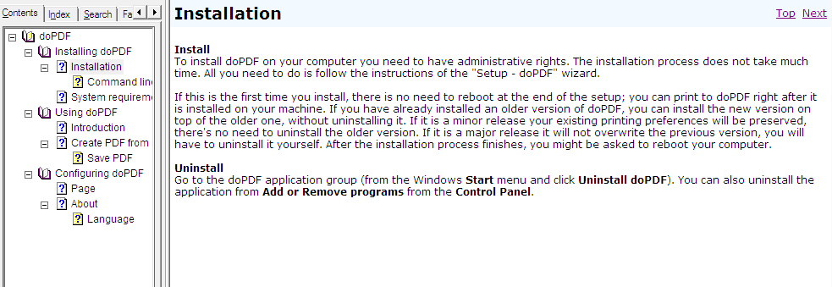
Example of Prose Format
Fatima M.AbuHjeela

Slide 17
3. Choose Appropriate Procedural Format
3. Parallel Format
This format comes in handy when you have a program that uses complicated data fields or dialog boxes. It works well when the user needs to fill out a form.
It can break down if the procedure get so long.
Directions to set up parallel format:
Keep the terminology consistent.
Cue the terms to the screen.
Discuss one screen item at a time.
Use plenty of examples.
Introduce the idea and explain the conventions used.
Fatima M.AbuHjeela

Slide 18
3. Choose Appropriate Procedural Format
3. Parallel Format
Advantages
Can help users stay organized
Works best with shorter procedures
Good for filling out complicated screens and dialog boxes
Disadvantages
Doesn’t present information in step-by-step ,task-oriented manner.
Can’t be used for all procedures.
Has to fit on one page.
May confuse users who can get lost moving between steps and screen .
Fatima M.AbuHjeela

Slide 19
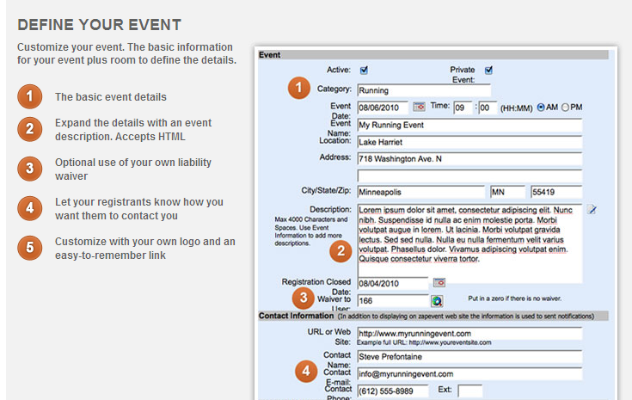
Example of Parallel Format
Fatima M.AbuHjeela

Slide 20
3. Choose Appropriate Procedural Format
4. Embedded Help (Interactive Assistance)
This provides help at the time of need in the field or interface object where the user is working.
Embedded help format and types:
Flyout Help: Appears in a box or panel on the screen at the user’s request.
Interface Help: Help information provided in the designated section of the screen.
Pop-up definitions: Provides brief definitions of interface elements activated by a mouse click.
Fatima M.AbuHjeela

Slide 21
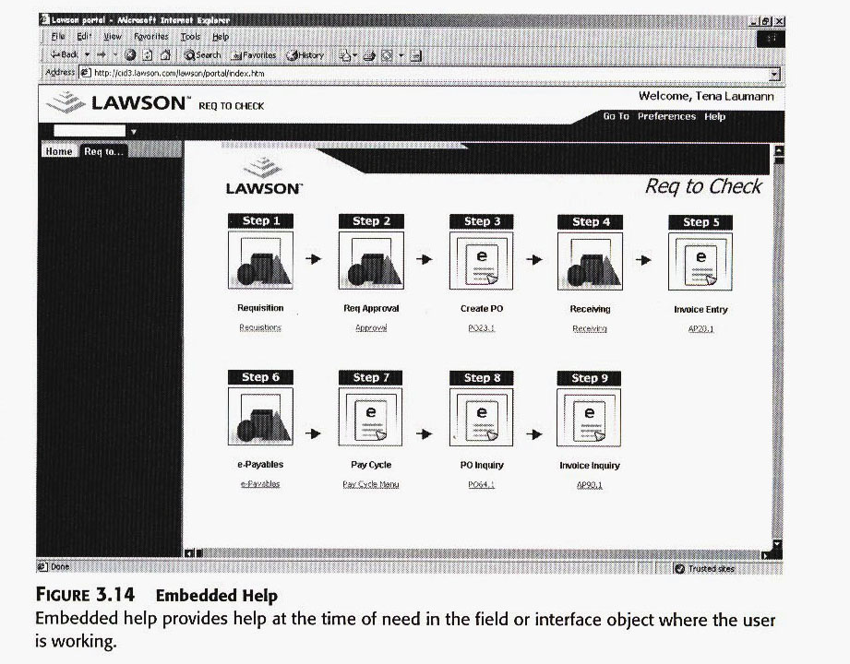
Example of Embedded Help

Slide 22
4.Follow a Rhythm of Exposition
A pattern of steps, note, and illustration.
The basic idea of a rhythm expositions lies in the action/response pattern.
Computer programs work in that way: take an action, the system response pattern .
Follow this sequence:
First, I give command for the step.
Then mention how the program will respond.
Then illustrate what happened.
Then tell the next step.
Fatima M.AbuHjeela

Slide 23
5.Test All Procedure for Accuracy
Perform usability testing with potential users to see if your procedure design has the required effect.
Make an Evaluation test ( after you finish the procedure ,you have an actual user, or a prototype of the user, or yourself as a last report, perform the steps .Get ready to have your eyes opened on all details and ,conditions, options and alternatives.
Fatima M.AbuHjeela

